Slide 1
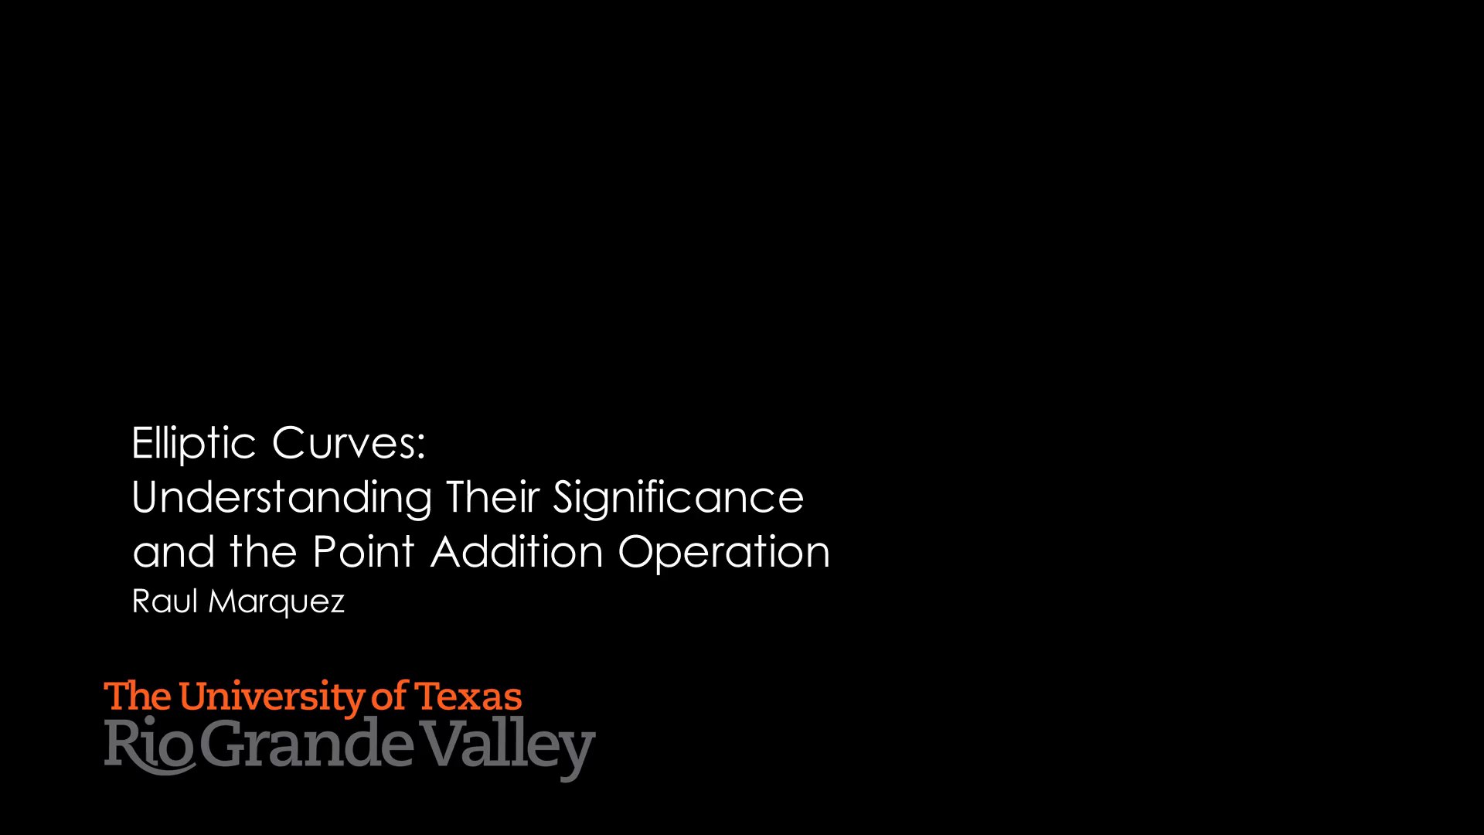

Slide 2
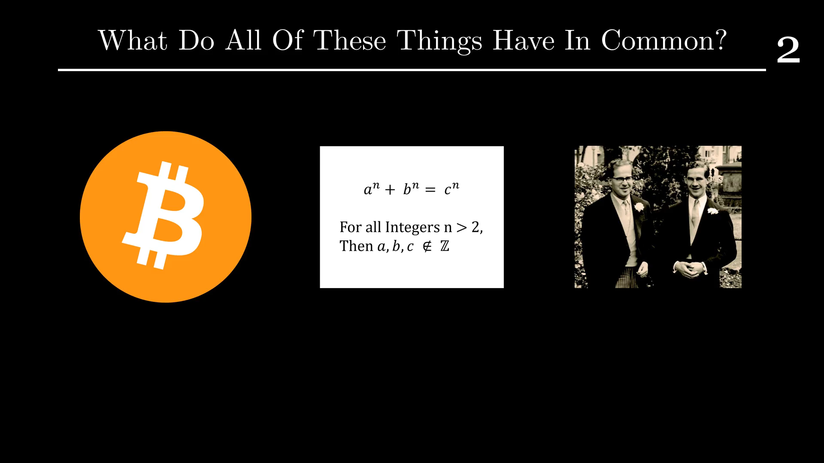

Slide 3
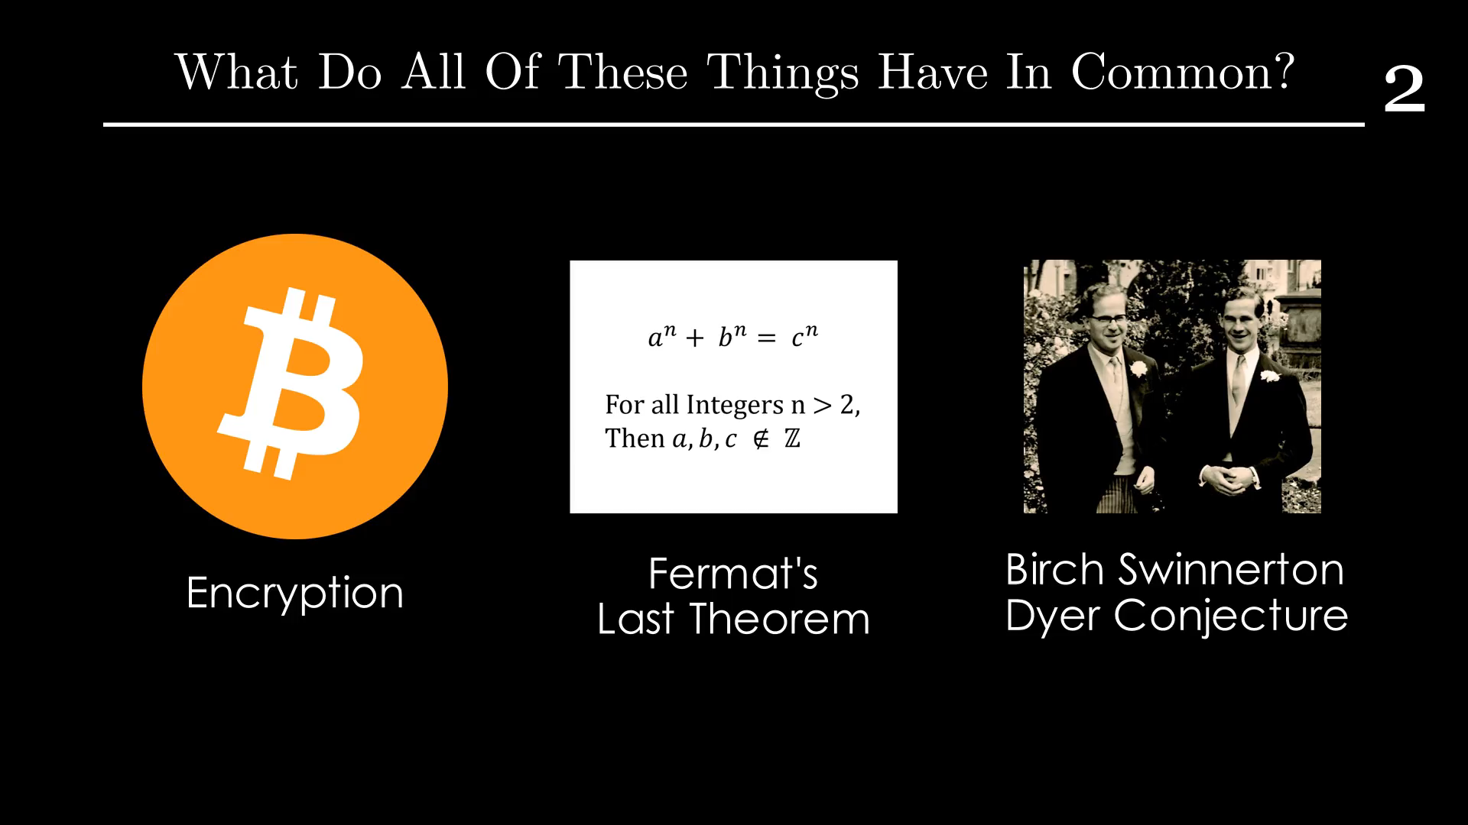

Slide 4
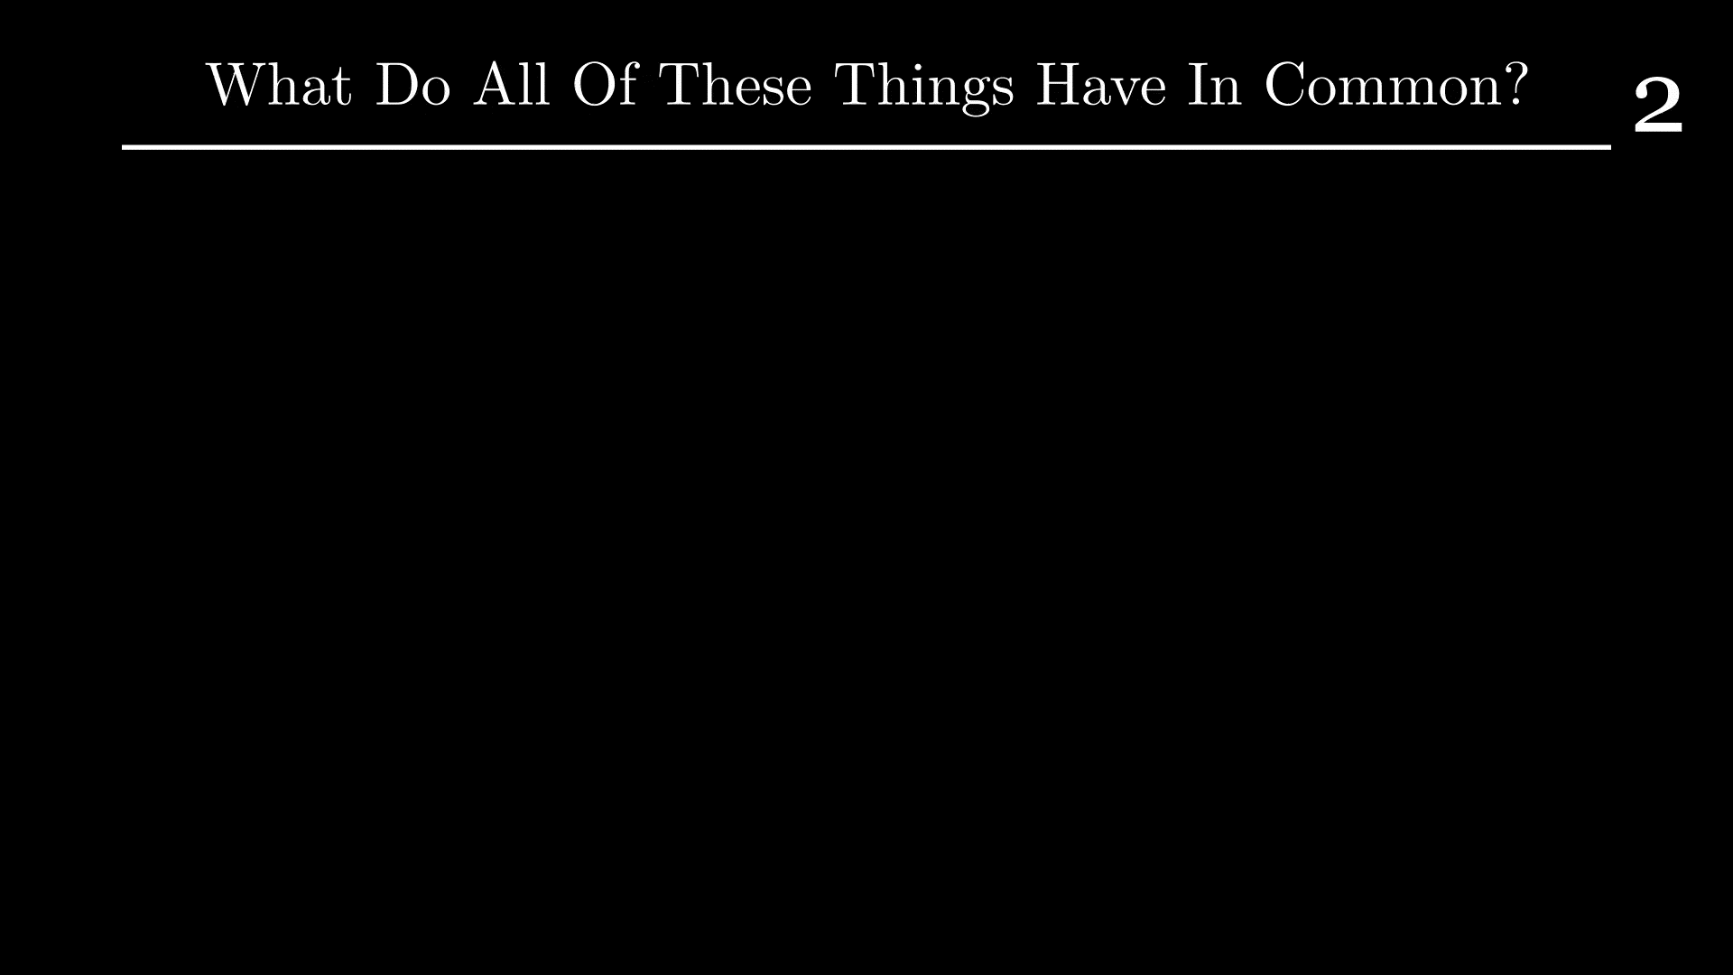

Slide 5
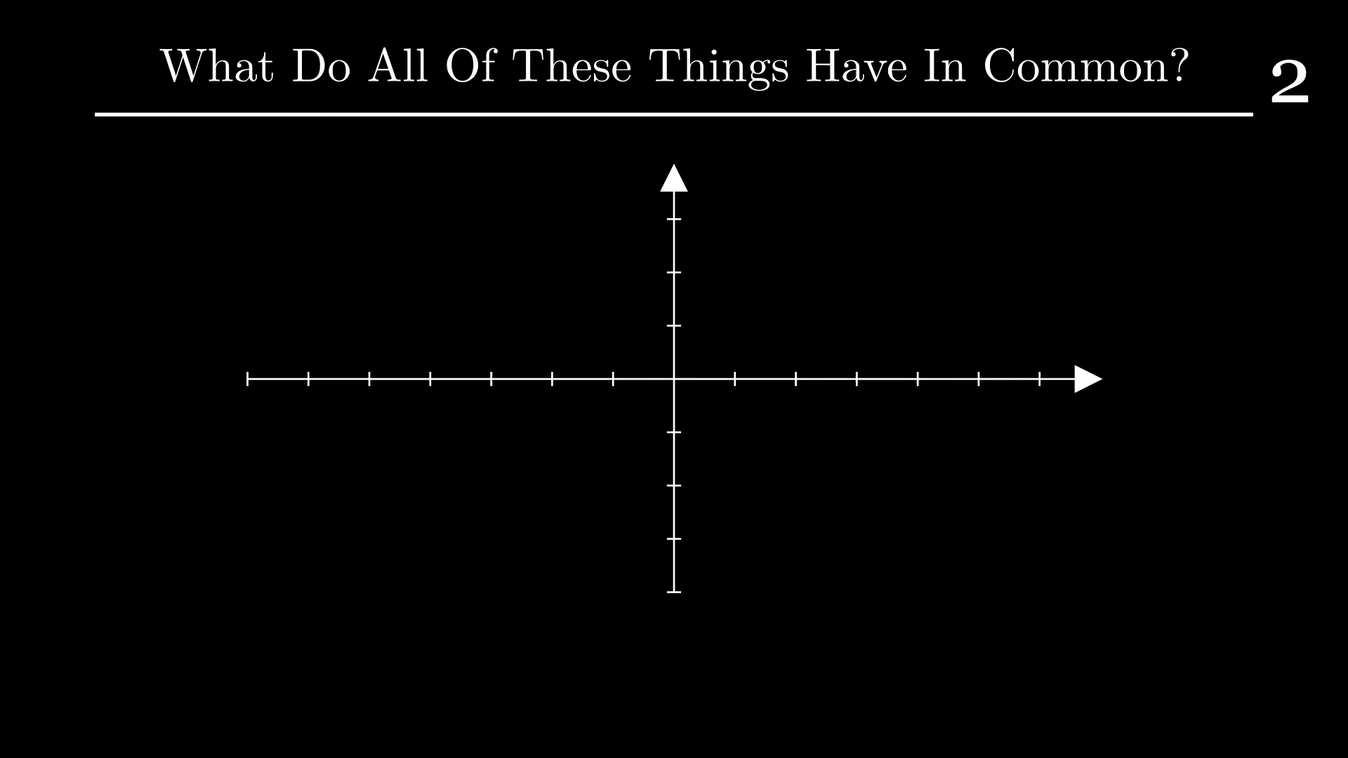

Slide 6
Table of Contents
3
A History of Elliptic Curves
Demo of Solving Rational Points
Definition of Elliptic Curve

Slide 7
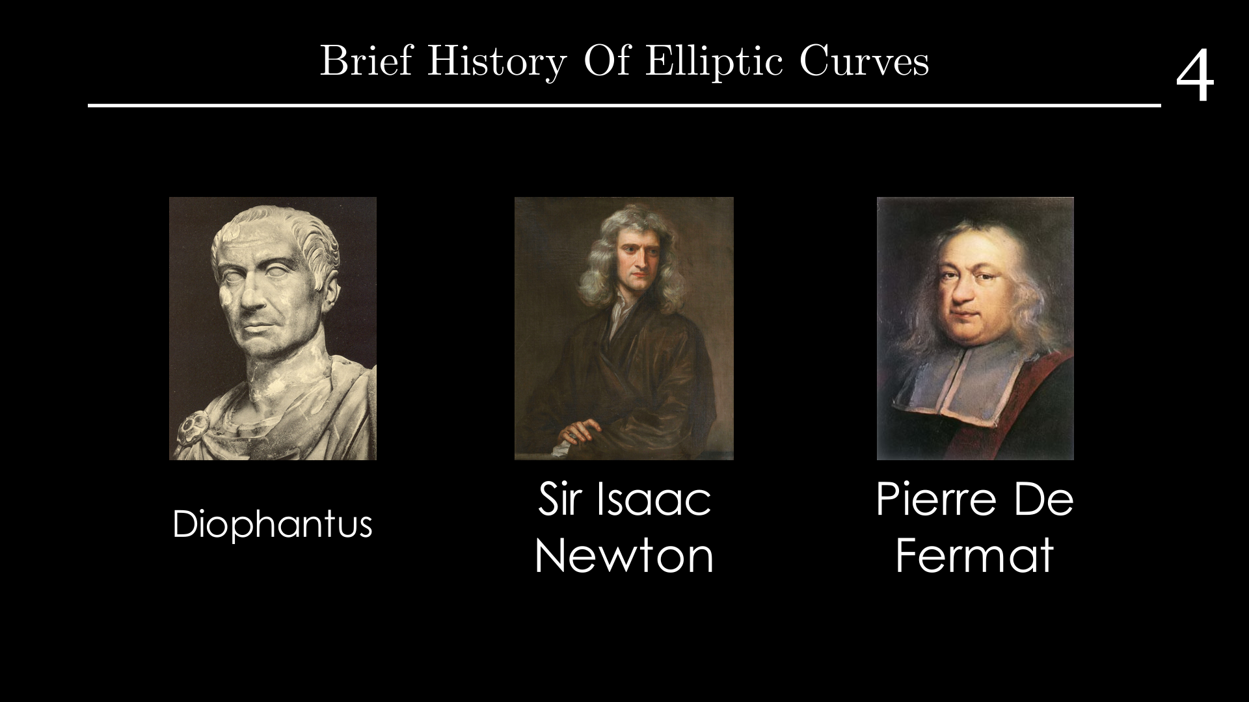

Slide 8
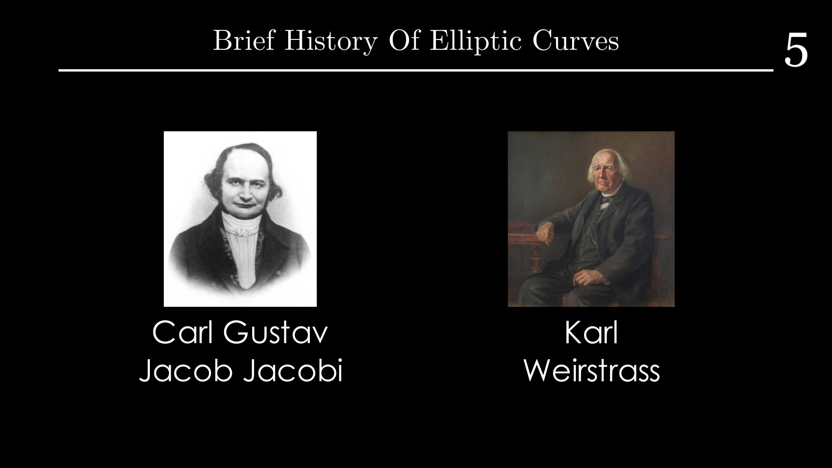
4

Slide 9
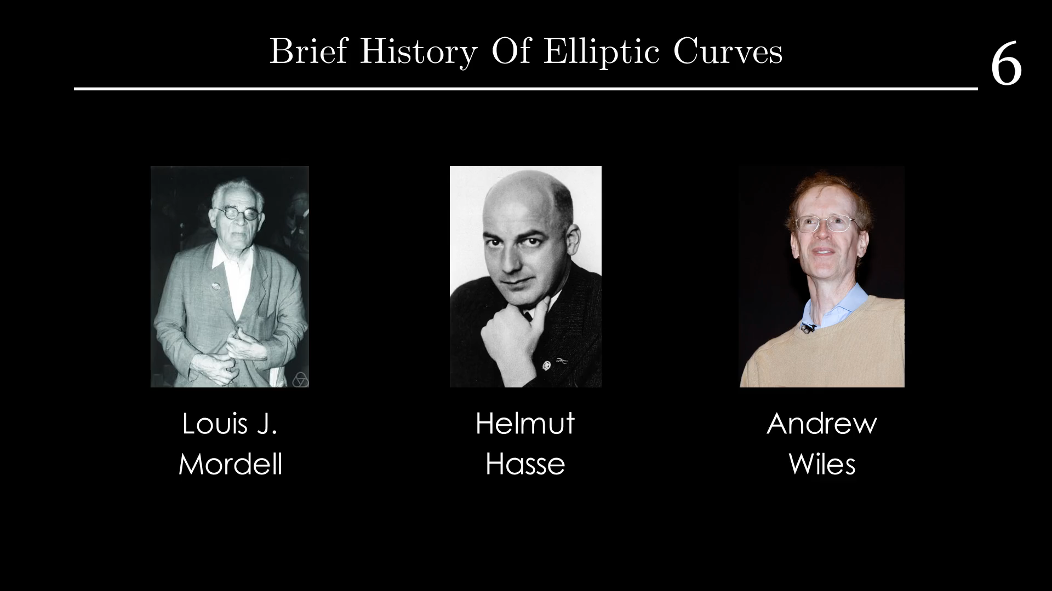
5

Slide 10
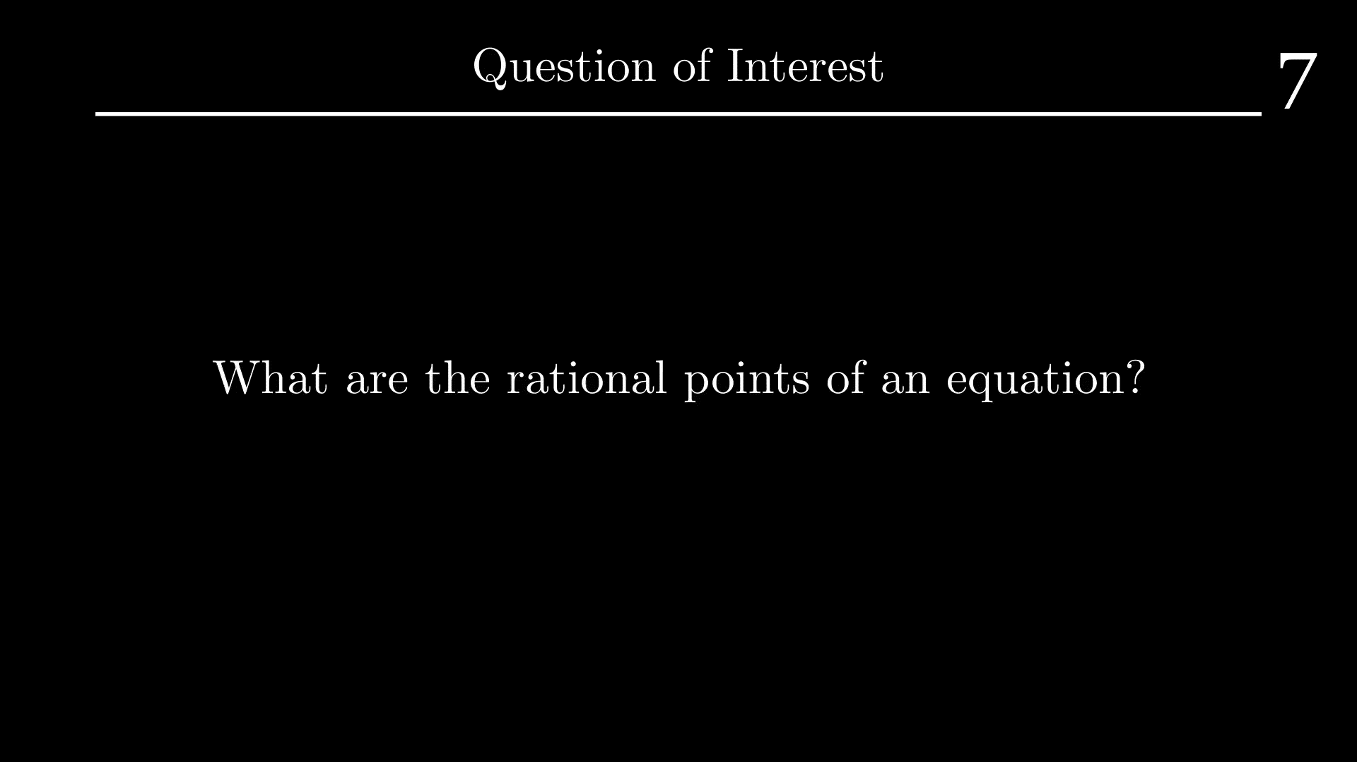

Slide 12
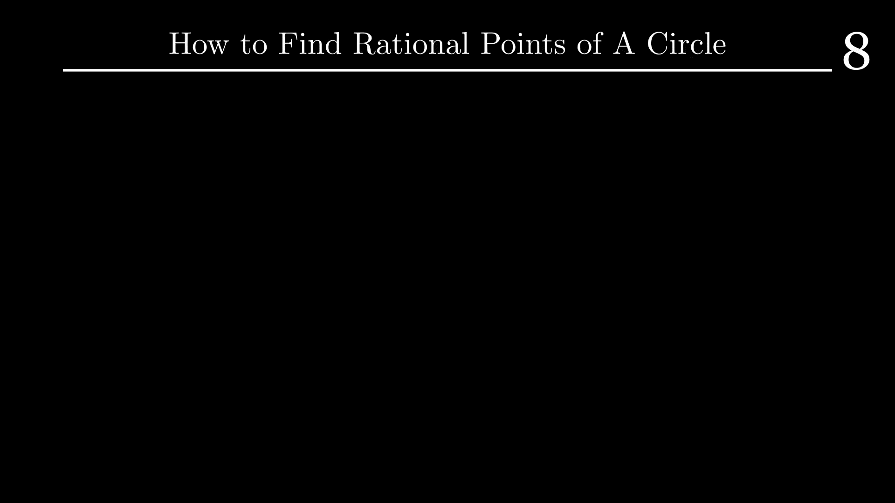

Slide 13
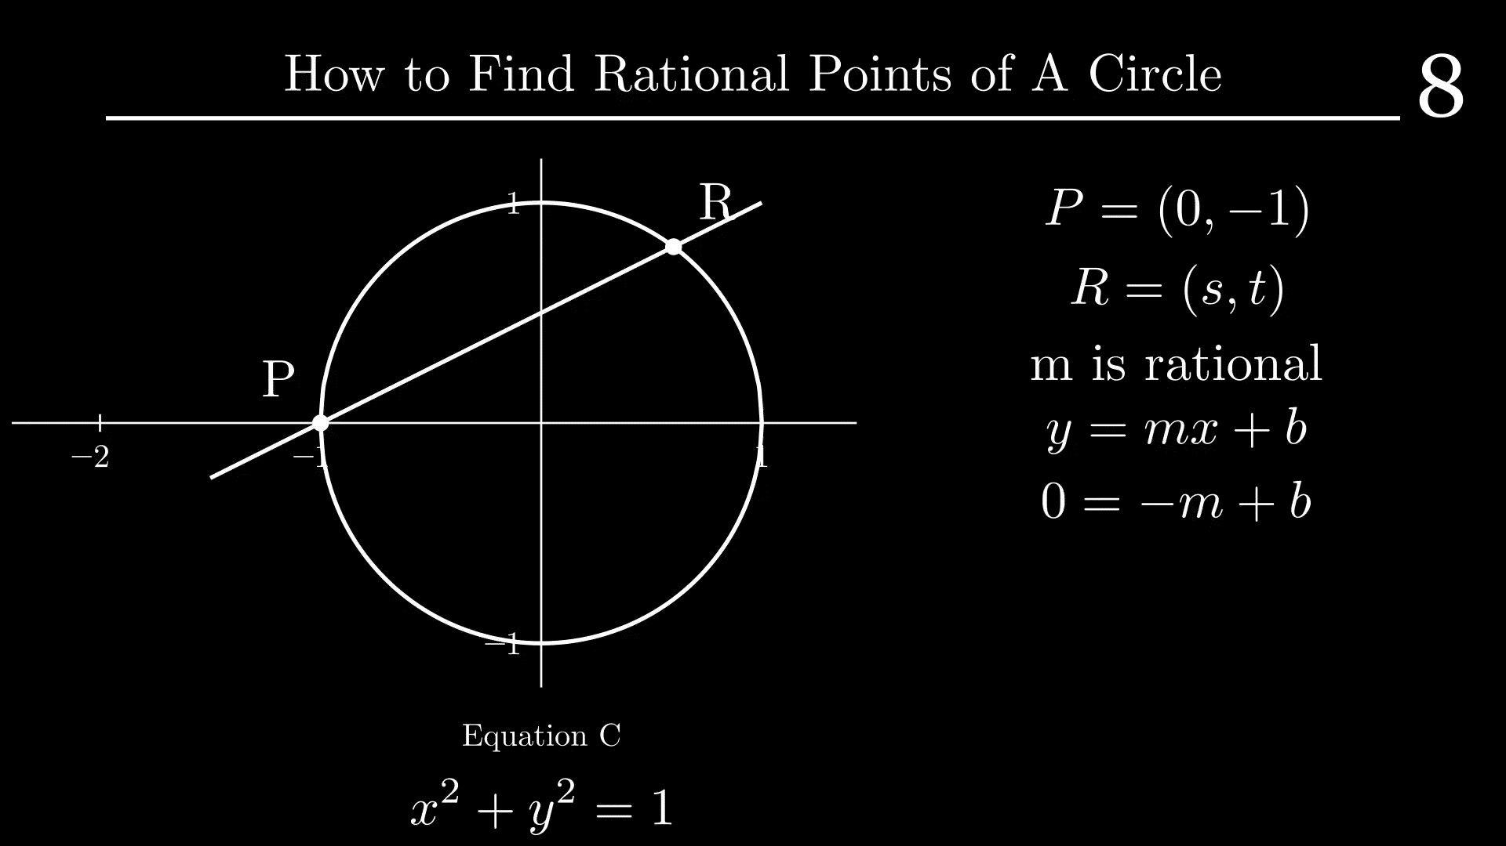

Slide 14
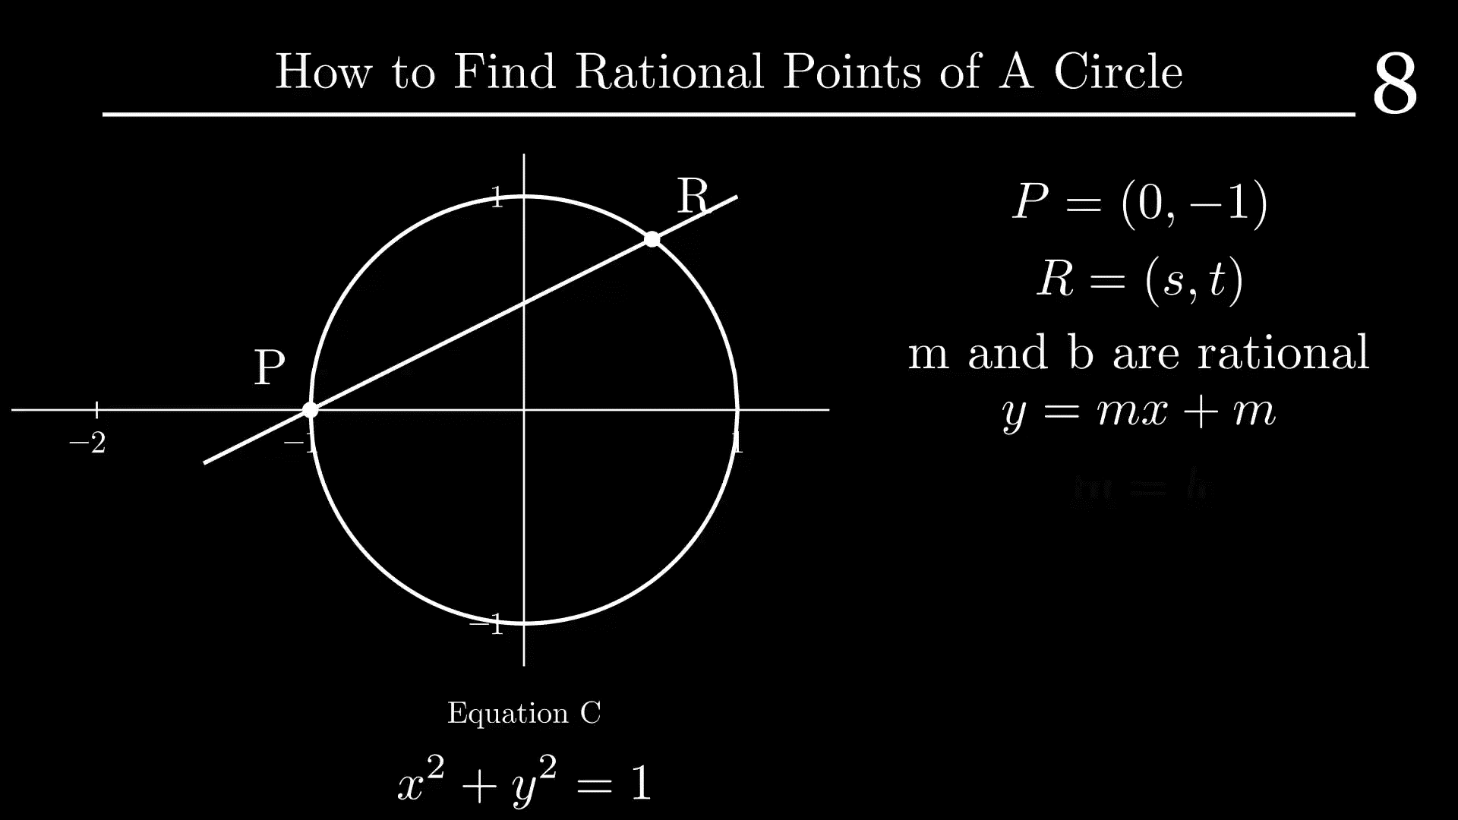

Slide 15
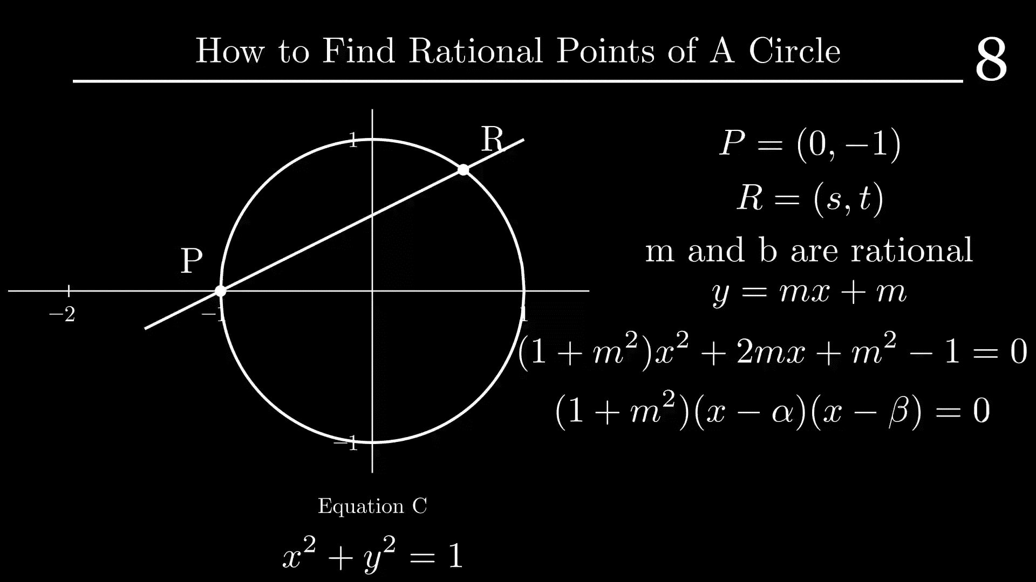

Slide 16
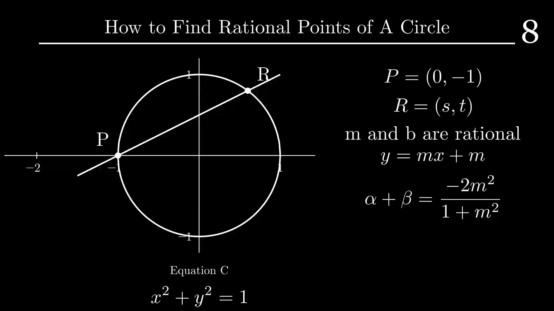

Slide 17
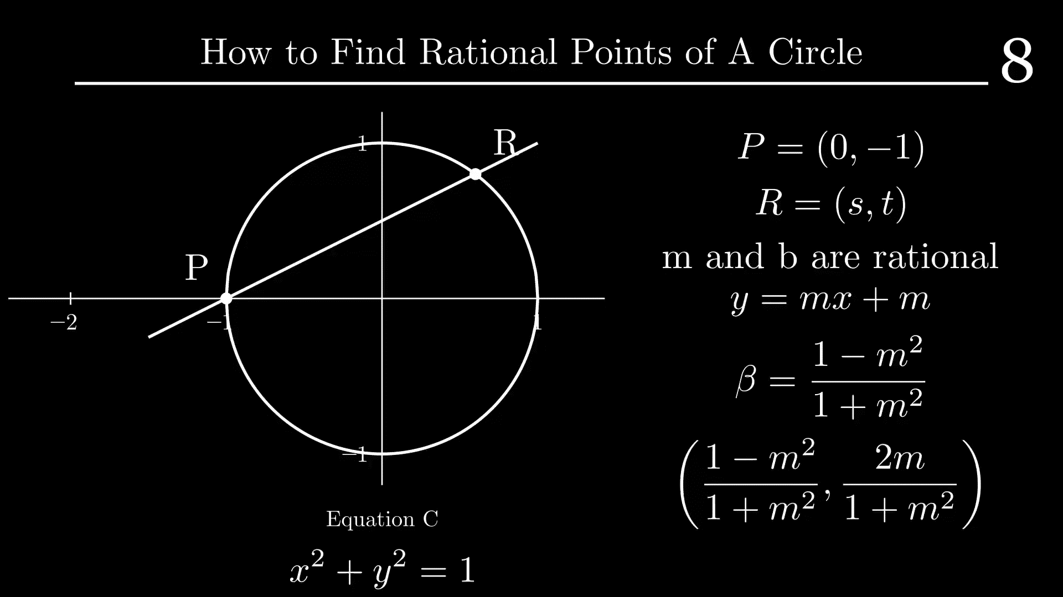

Slide 18
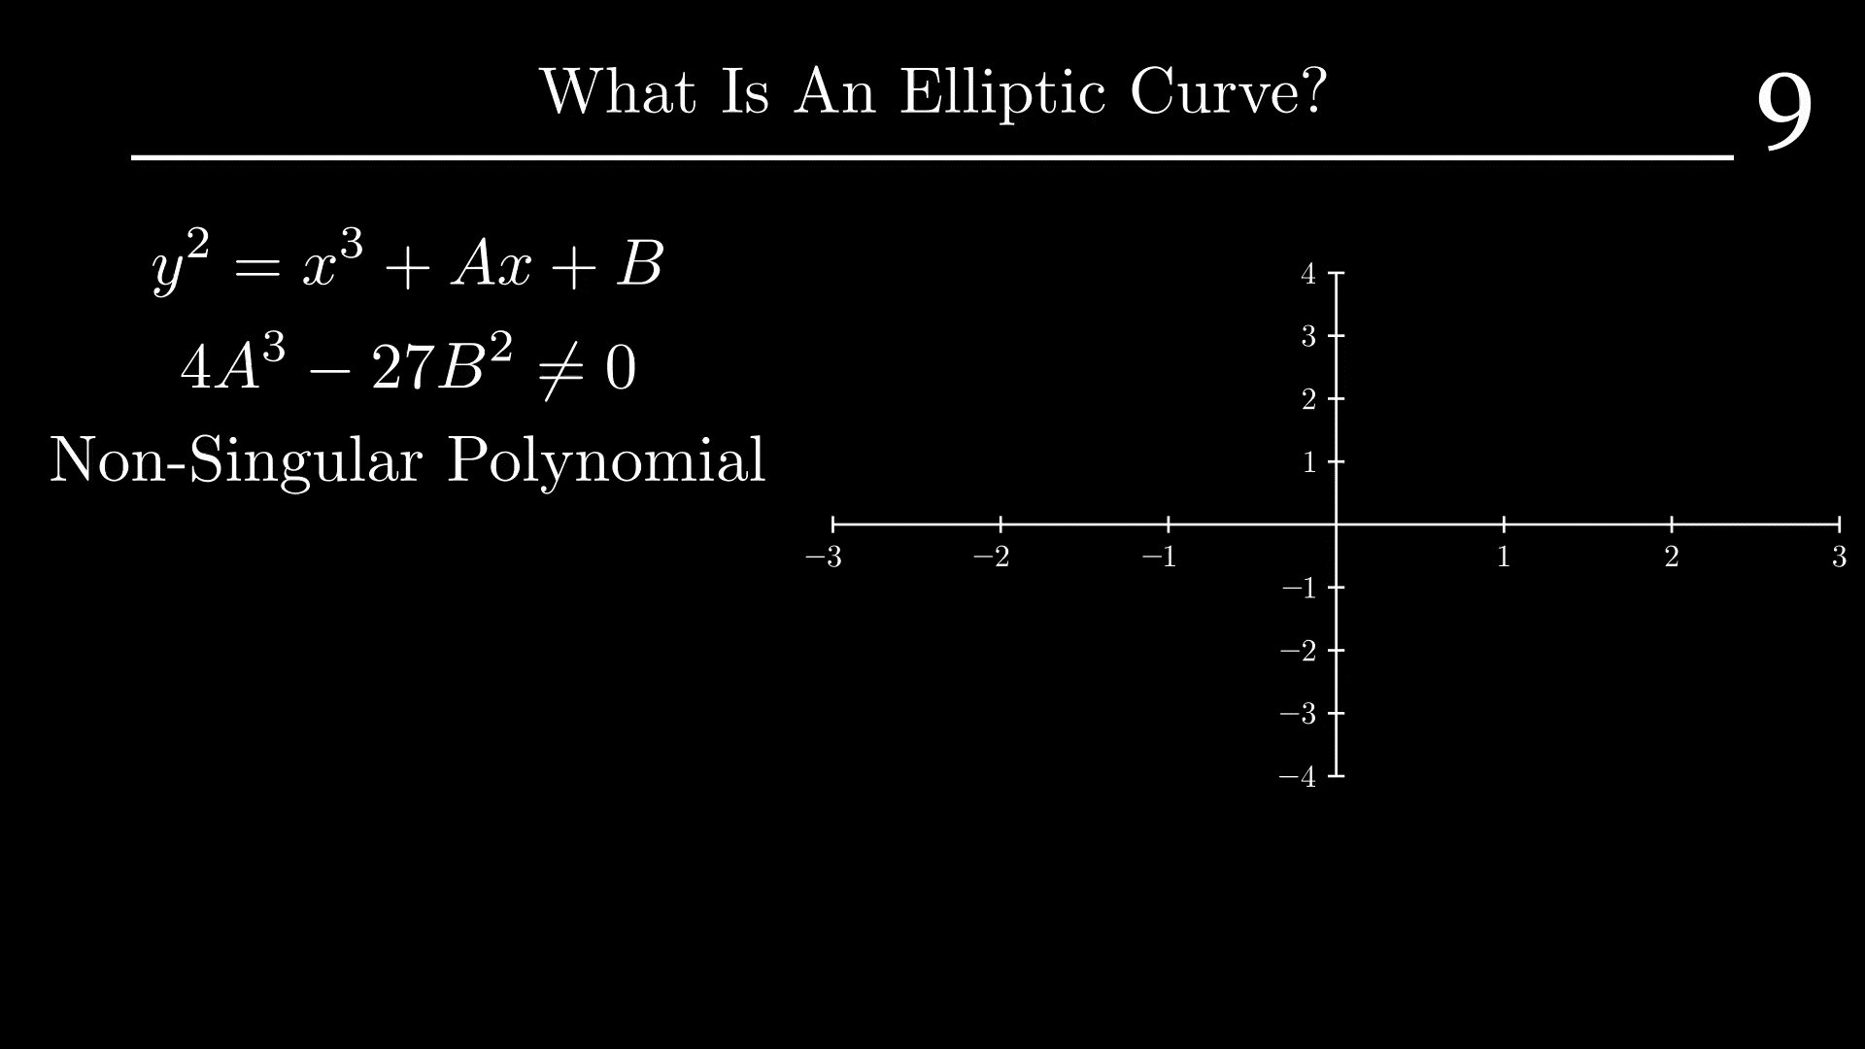

Slide 19
Definition of Group
10
1.) Closed under Set: Any elements under the operation give you another element
2.) Identity: A unique element that does not act on an element
3.) Associative Property: Sequence of operations doesn’t matter
4.) Inverse Element: A unique element will take you back to the identity
Example: Integers can be added and subtracted
Integer + Integer = Integer, x + 0 = x, a + (b + c) = (a + b) + c, a + (-a) = 0
Non-Example: Multiplication among integers isn’t a group
Integer * (1/Integer) = 1, (1/Integer) is not an integer

Slide 20
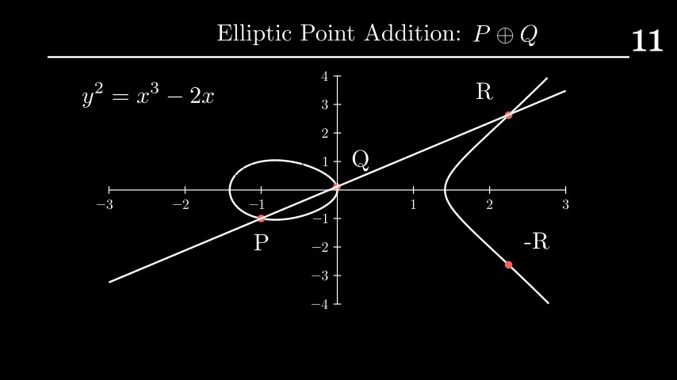
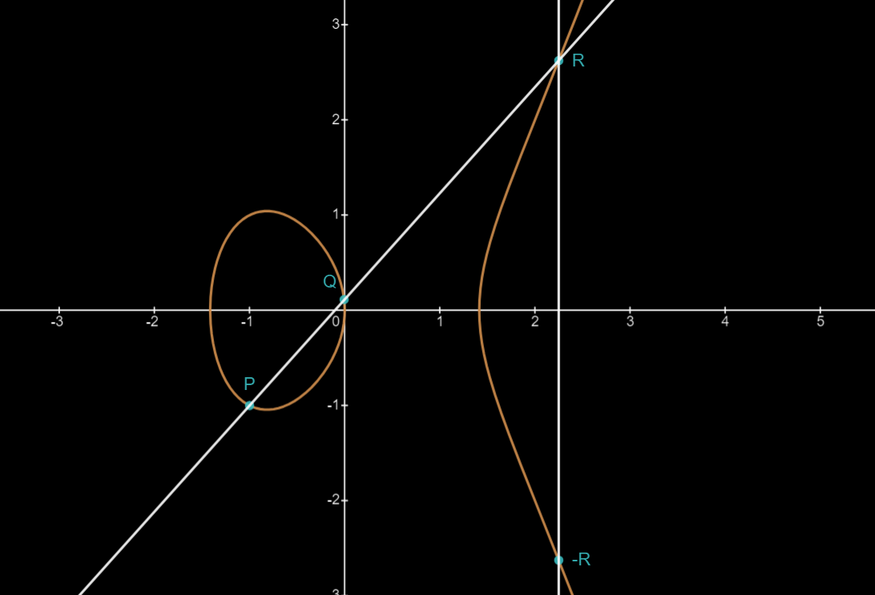

Elliptic Curve Addition
11
Elliptic Point Addition: $P⨁Q$

Slide 21
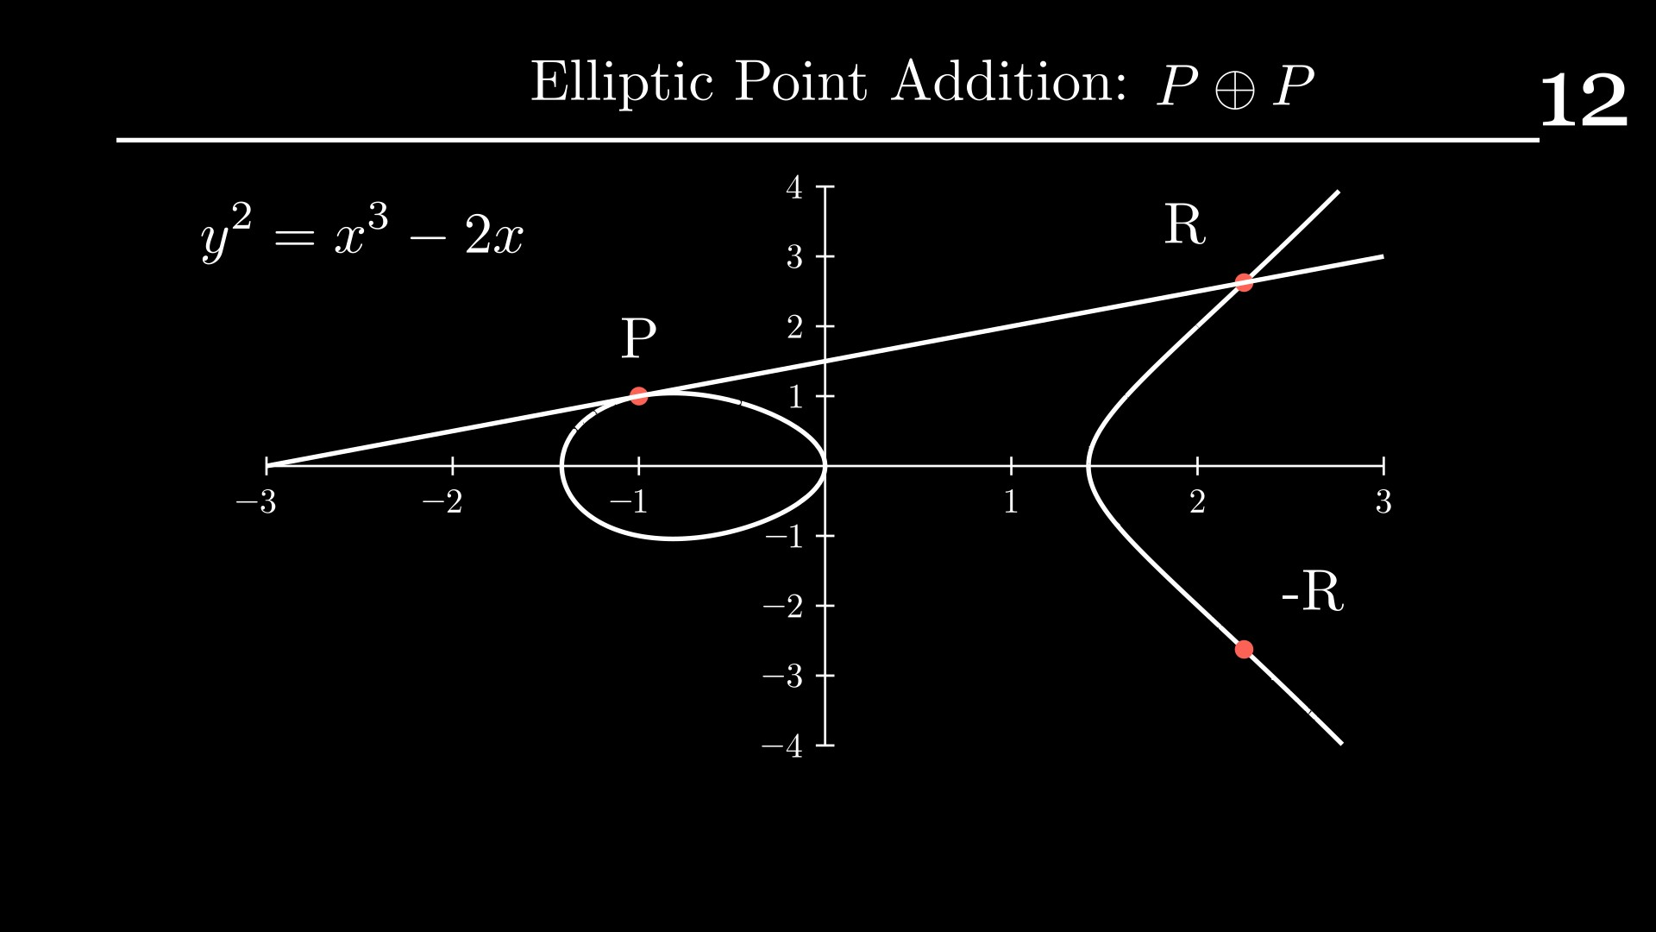
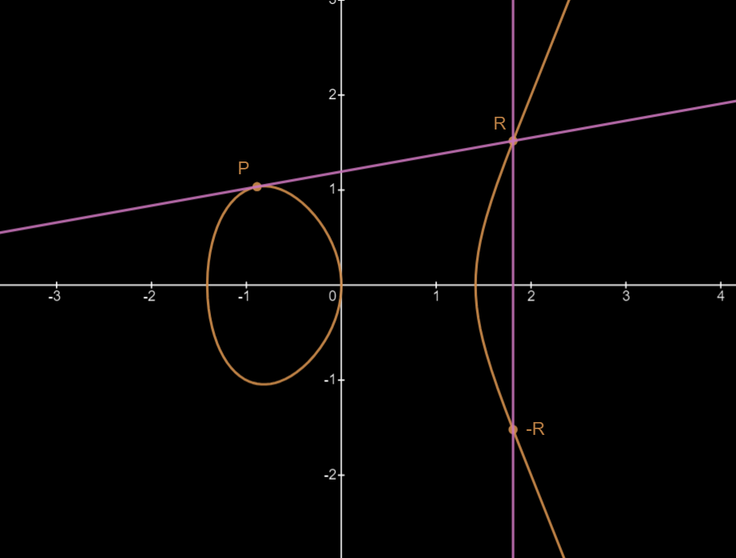


Elliptic Curve Addition
12
Elliptic Point Addition: $P⨁P$

Slide 22

Conclusion
13

